Slide 1
DS 6373: Unit 2 Live Session

Slide 2
Erratum: VXBAR CODE / Unit 1 Breakout Code

Slide 3
Breakout 1

Slide 4
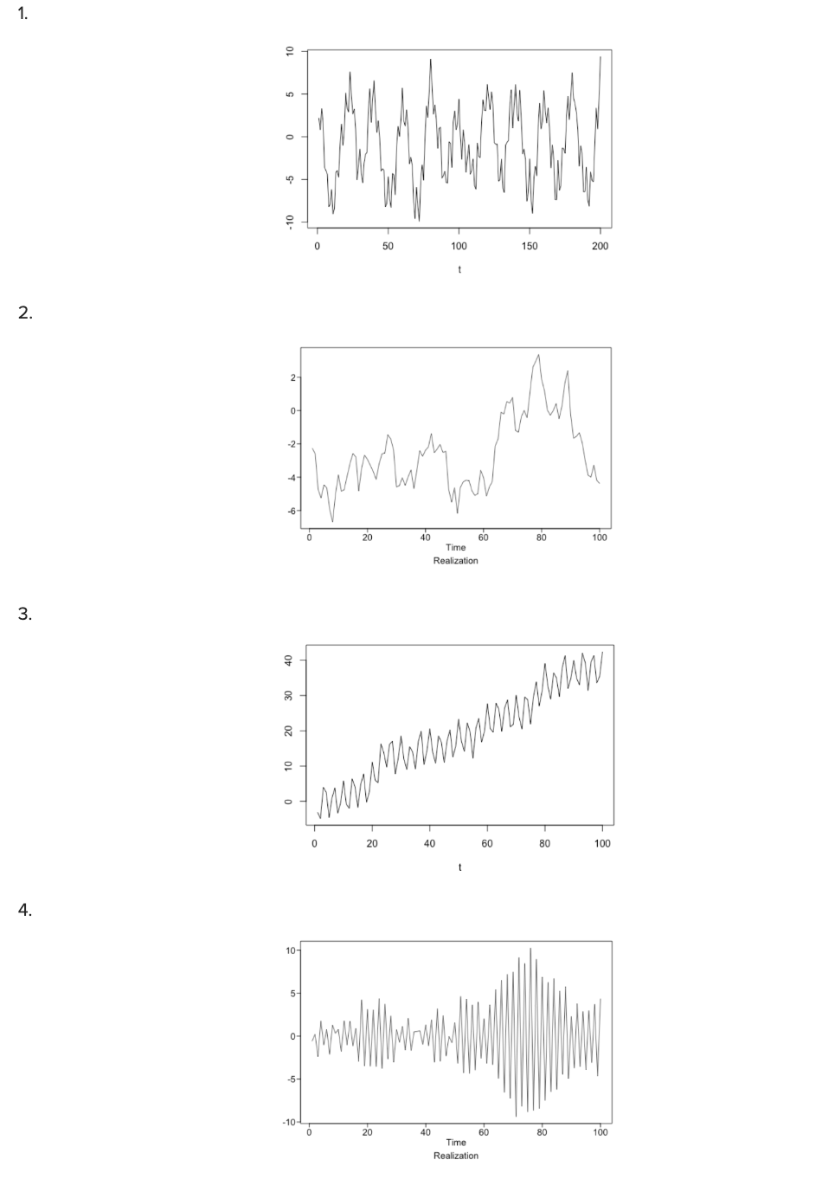
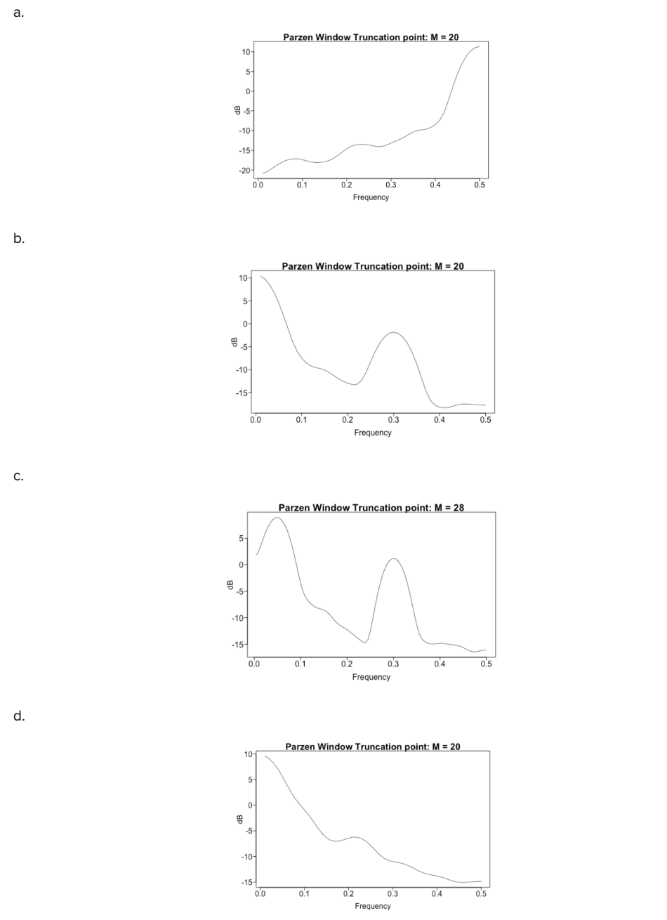
Match’em Up!

Slide 5
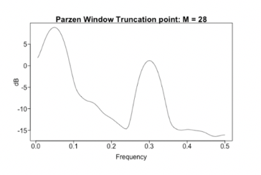
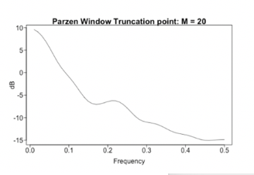
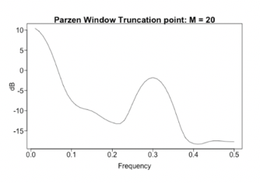
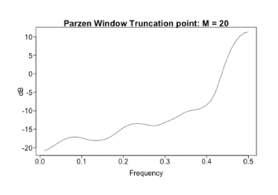
Match’em Up!

Slide 6
End Breakout 1

Slide 7
Breakout 2

Slide 8
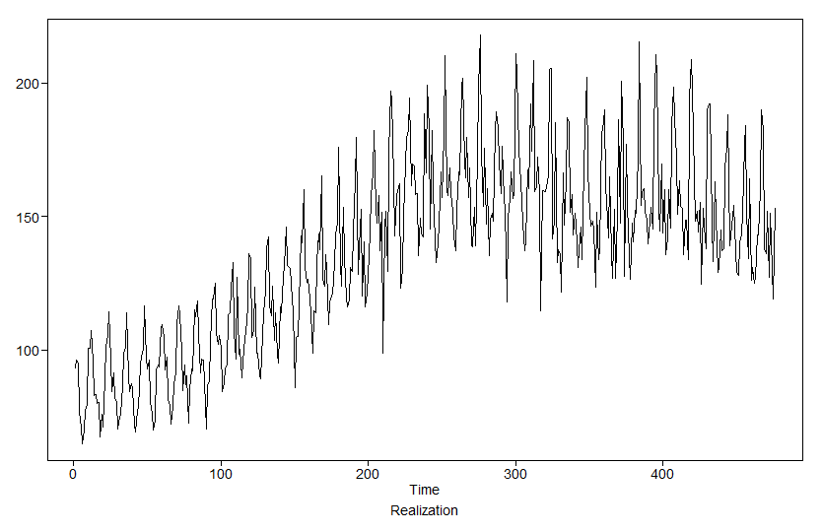
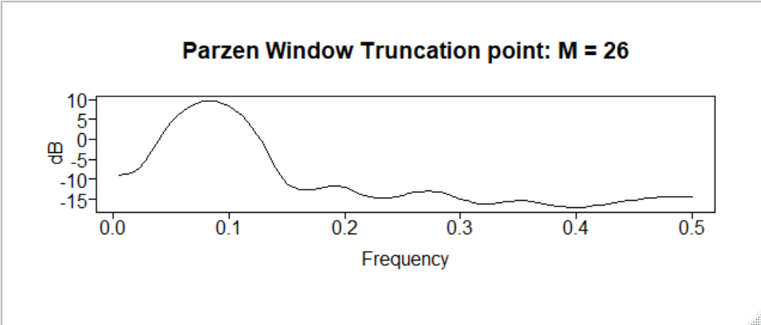
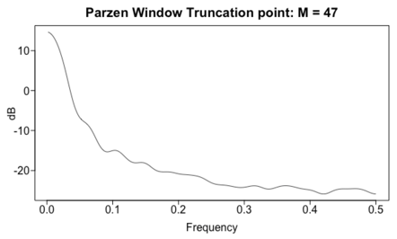
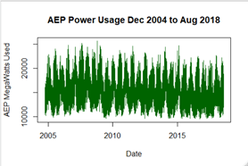
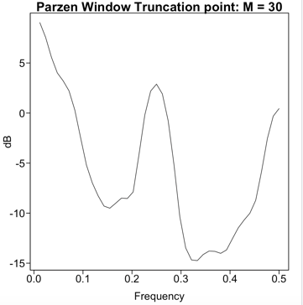
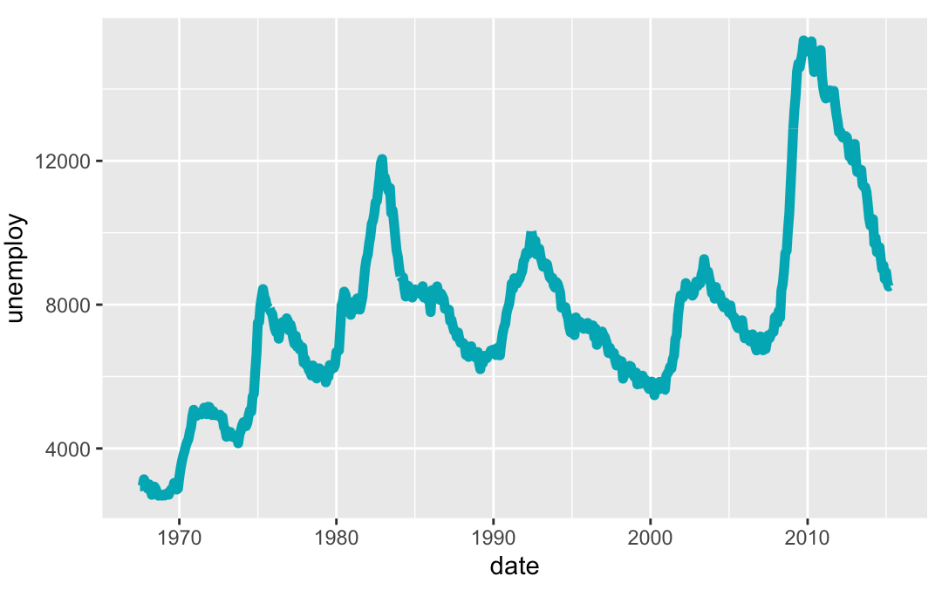
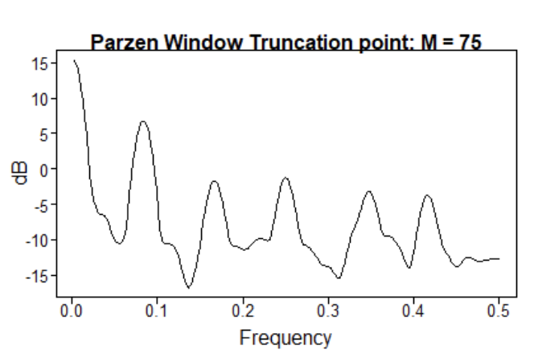
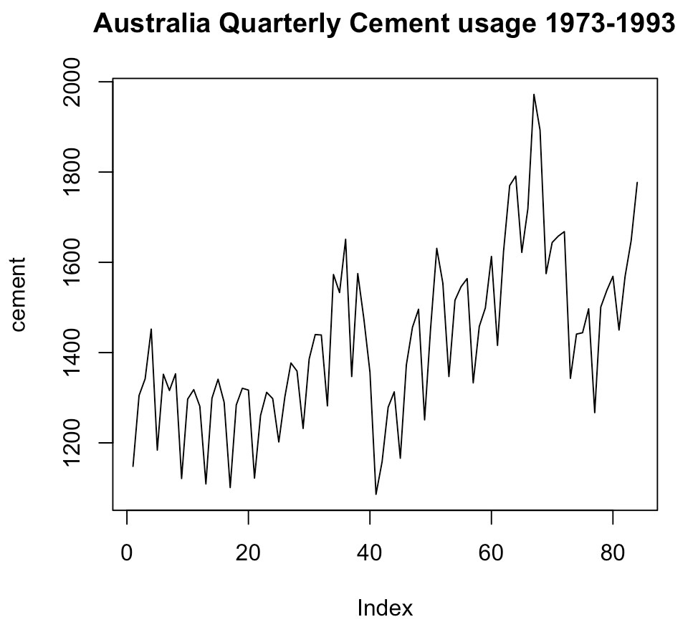
Match’em Up! Part 2
1
a
Hourly
2
b
3
c
4
d

Slide 9
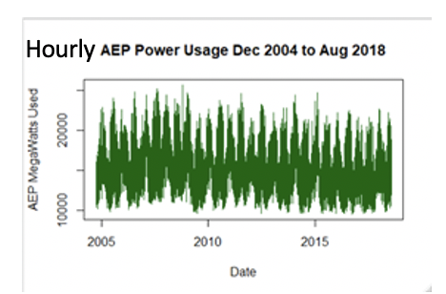
Match’em Up! Part 2
1
b
2
c
3
d
4
a

Slide 10
End Break Out 2

Slide 11
Breakout 3

Slide 12
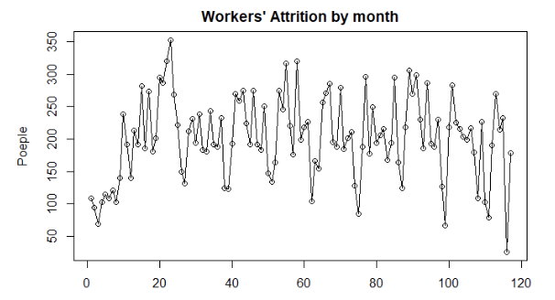
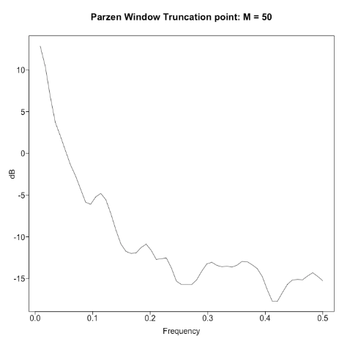
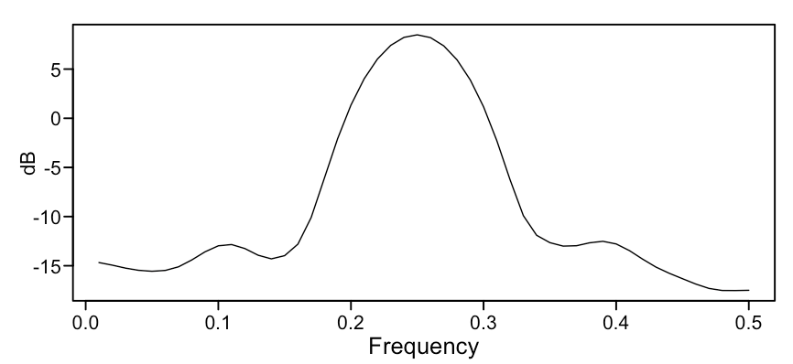
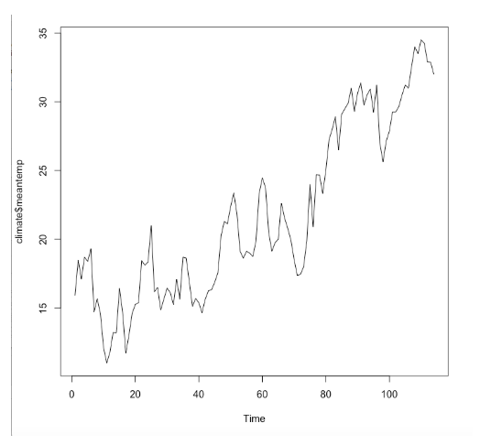
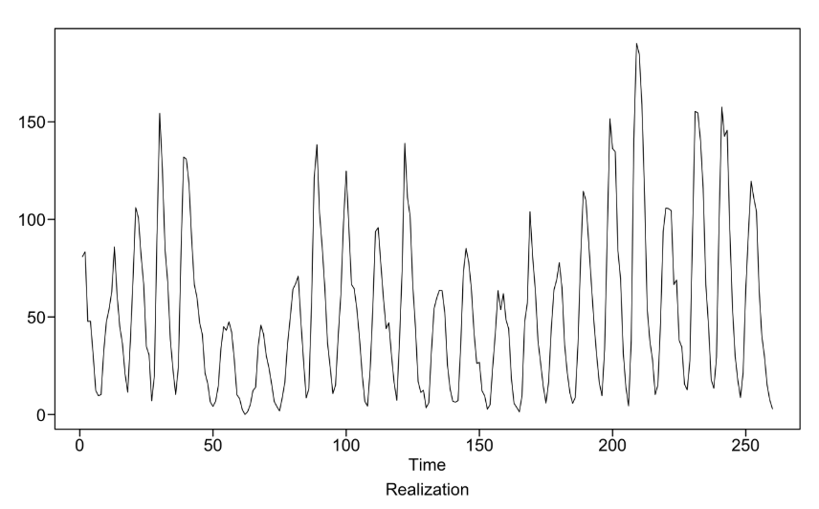
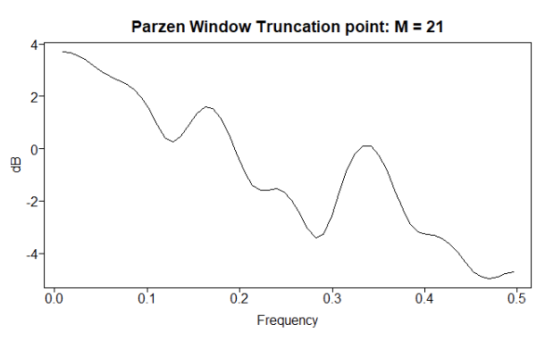
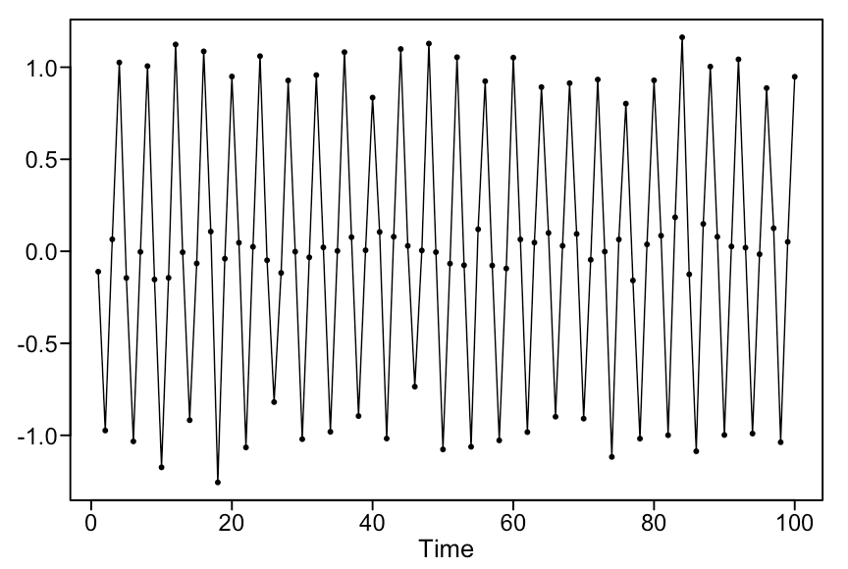
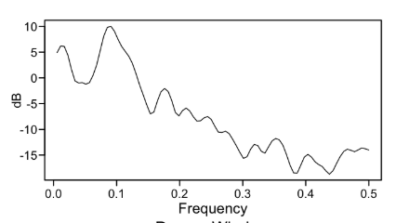
Match’em Up Part 2

Slide 13
Match’em Up Part 2

Slide 14
End Break Out 3

Slide 15
Aggregating

Slide 16
Power Usage By Minute for 6 months

Slide 17
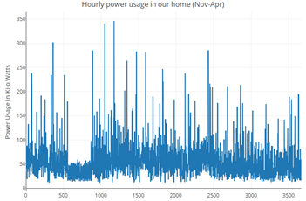
Hourly Power Usage

Slide 18
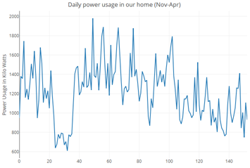
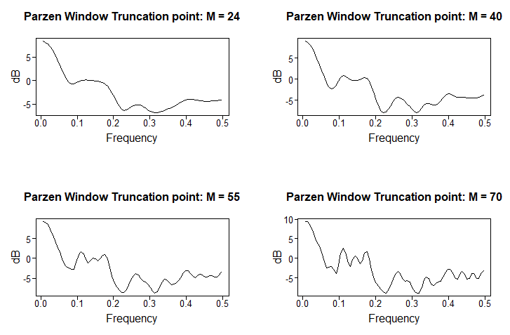
Daily Power Usage

Slide 19
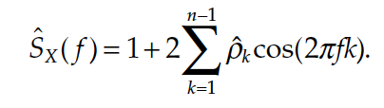
Question … What should the Spectral Density of White Noise Look Like?

Slide 20
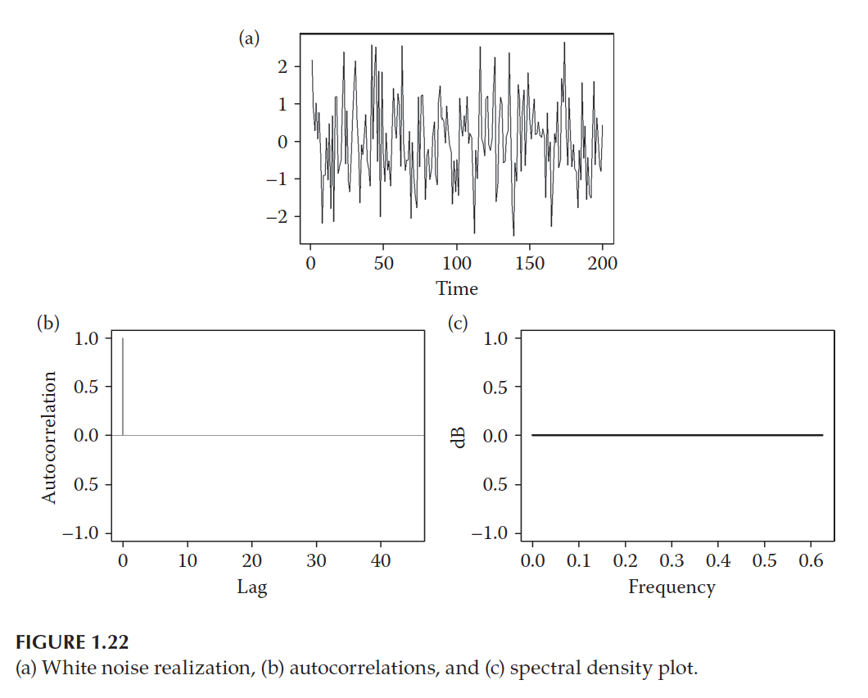
Why is the True Spectral Density Shown Below Always at Zero?

Slide 21
Generate 1000 observation of from a white noise process and find the sample spectral density using a Parzen Window.

Slide 22
Break Out

Slide 23
Break Out
Load the Data
Filter the data to get only the sales for Store 8 and Item 1.
Stor8Item1 = Walmart %>% filter(item == 1 & store == 8)
Does the data come from a stationary process? Make sure and address all 3 conditions.
The client believes there is yearly and weekly seasonality in the data. Is there evidence of this with respect to the spectral density?

Slide 24
Extras

Slide 25
Breakout 2

Slide 26
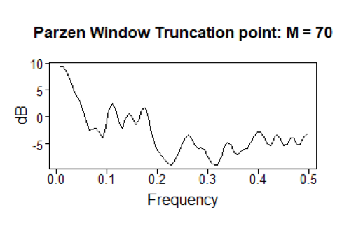
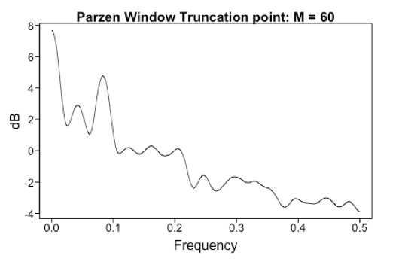
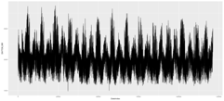
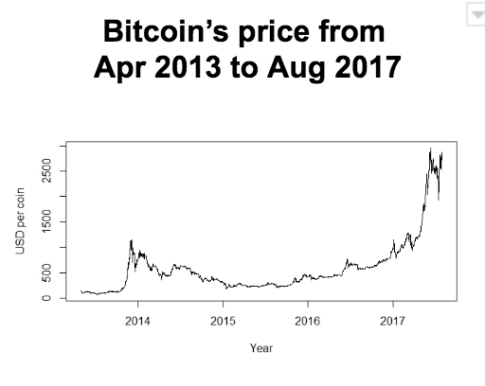
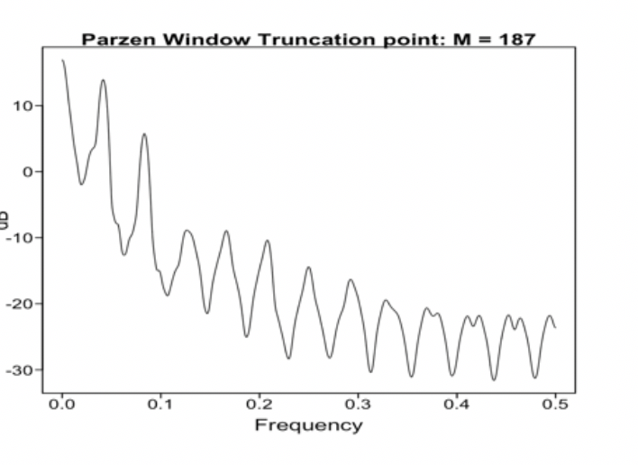
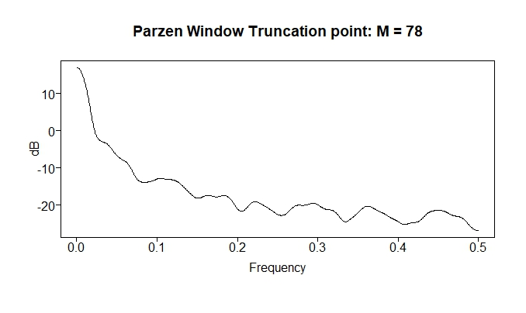
Match’em Up! Part 2
1
a
2
b
3
c
4
d

Slide 27
Match’em Up! Part 2
1
d
2
a
3
b
4
c

Slide 28
End Break Out 2

Slide 30
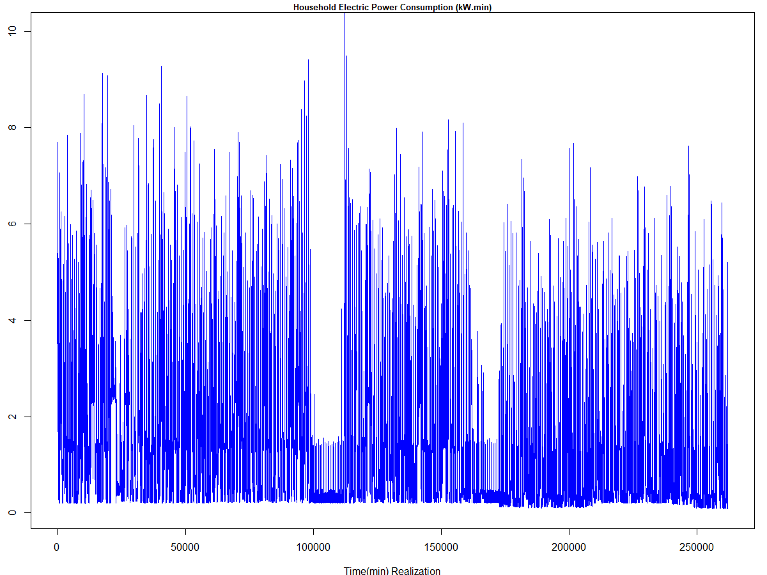
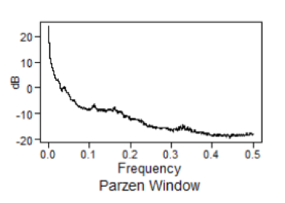
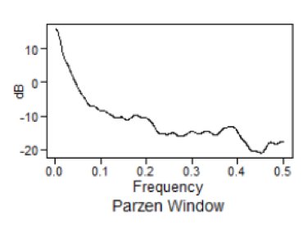
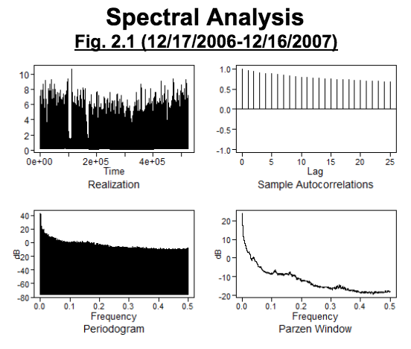
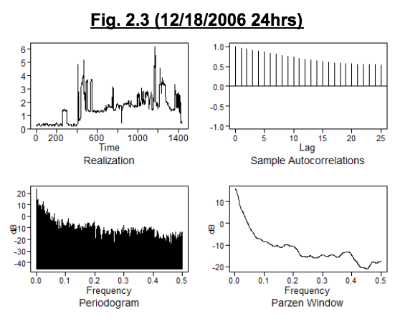
1 Year
24 Hours

Slide 31

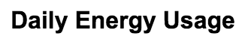
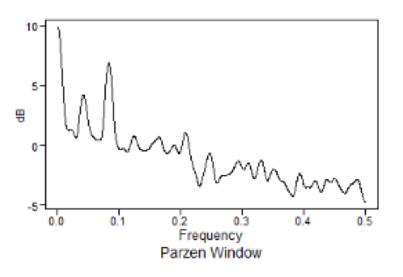
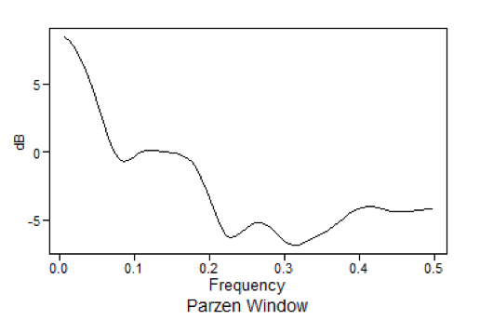
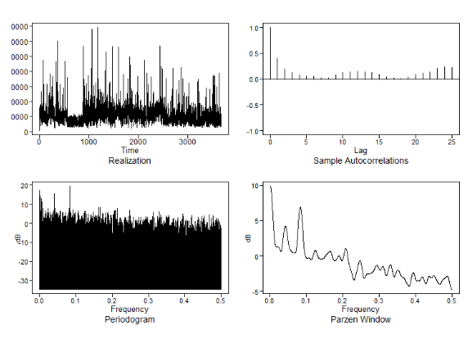
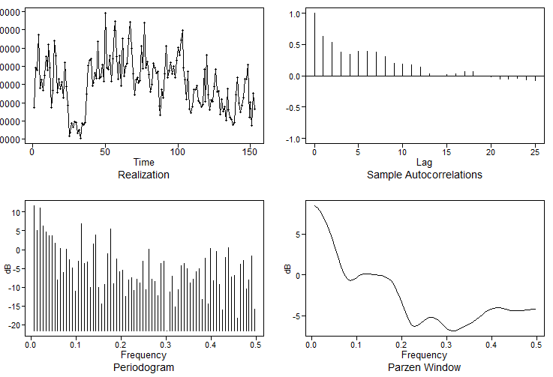

Slide 32
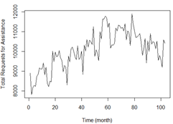
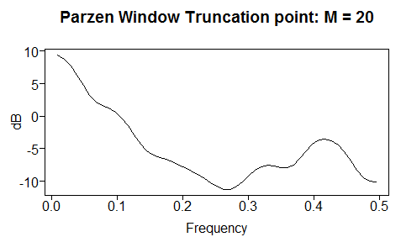
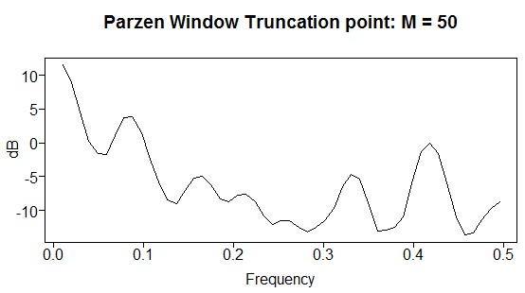
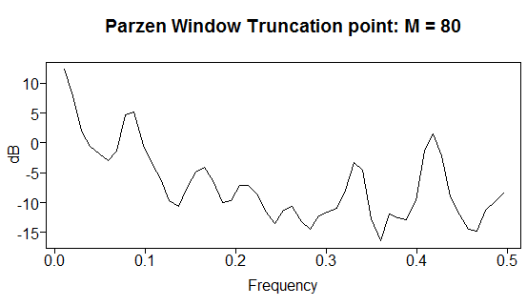

Slide 34
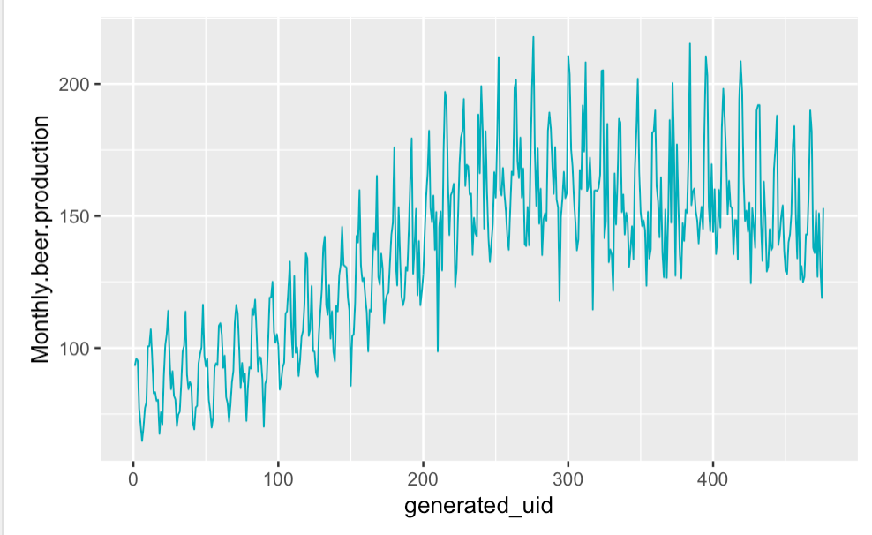
Monthly Beer Production

Slide 35
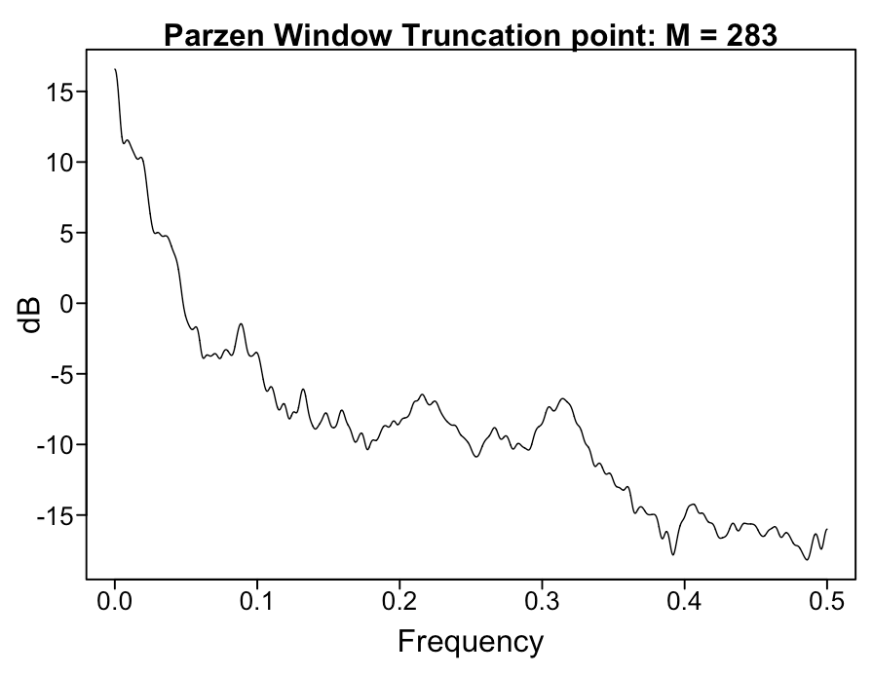
Power Usage By Minute for 2 Weeks
plotts.wge(homepowerusage$usageValue[1:20160])
parzen.wge(homepowerusage$usageValue[1:20160])

